Slide 1


FROM IMPLEMENTATION RESEARCH TO IMPACT The GACD Diabetes Research Programme Report

Slide 2
Terms of use – plain language
You can copy, share, and change this material, but you must give credit to the original creator.
You cannot use it for profit.
In short, you are free to use it for non-commercial purposes, but you should be respectful of the original creator’s work and attribute accordingly.

Slide 3

Terms of use – details
This presentation is licensed under the Creative Commons Attribution-NonCommercial 4.0 International licence
You are free to:
Share - copy and redistribute the material in any medium or format
Adapt - remix, transform, and build upon the material
The licensor cannot revoke these freedoms as long as you follow the license terms.
Under the following terms:
Attribution - You must give appropriate credit, provide a link to the license, and indicate if changes were made. You may do so in any reasonable manner, but not in any way that suggests the licensor endorses you or your use.
NonCommercial - You may not use the material for commercial purposes.
No additional restrictions - You may not apply legal terms or technological measures that legally restrict others from doing anything the license permits.
Notices:
You do not have to comply with the license for elements of the material in the public domain or where your use is permitted by an applicable exception or limitation.
No warranties are given. The license may not give you all of the permissions necessary for your intended use. For example, other rights such as publicity, privacy, or moral rights may limit how you use the material.

Slide 4
Overview of the presentation
About GACD
7
Implementation strategies
1
Aims of the report
8
Key findings
2
The projects
9
Impact
3
Theories of change
10
Lessons learned
4
Stakeholder engagement
11
Conclusions
5
Research methods
Acknowledgements
6
Assessing context

Slide 5
About GACD and implementation science

Slide 6
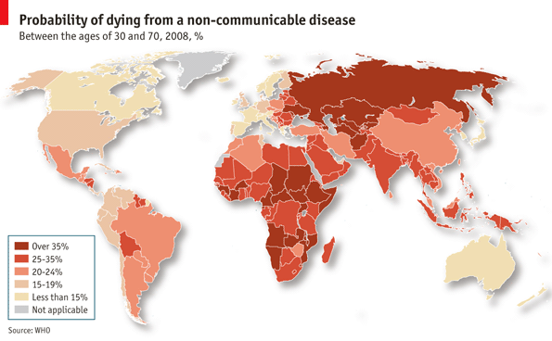



The worldwide burden of non-communicable diseases is increasing
Notes:
NCD facts and figures
NCDs kill 41 million people each year, equivalent to 71% of all deaths globally.
77% of all NCD deaths are in low- and middle-income countries.
Cardiovascular diseases 17.9 million deaths annually, followed by cancers (9.3 million), respiratory diseases (4.1 million), and diabetes (1.5 million). (Together 80% of premature NCD deaths)
People of all age groups, regions and countries are affected by NCDs
15 million of all deaths attributed to NCDs occur between the ages of 30 and 69 years..
Poverty is closely linked with NCDs, vulnerable and socially disadvantaged people get sicker and die sooner, in low-resource settings, health-care costs for NCDs quickly drain household resources.
Tobacco use, physical inactivity, the harmful use of alcohol and unhealthy diets all increase the risk of dying from an NCD.
Chronic conditions directly threaten SDG progress, which includes a goal to reduce global chronic condition related deaths by one third by 2030
A rising toll of Years of Life Lost from NCDs, partly driven by population growth and ageing
Compared with 2016, NCDs are forecast to account for a greater proportion of YLLs in all GBD regions by 2040
Need context specific global research to inform practice and policy

Slide 7
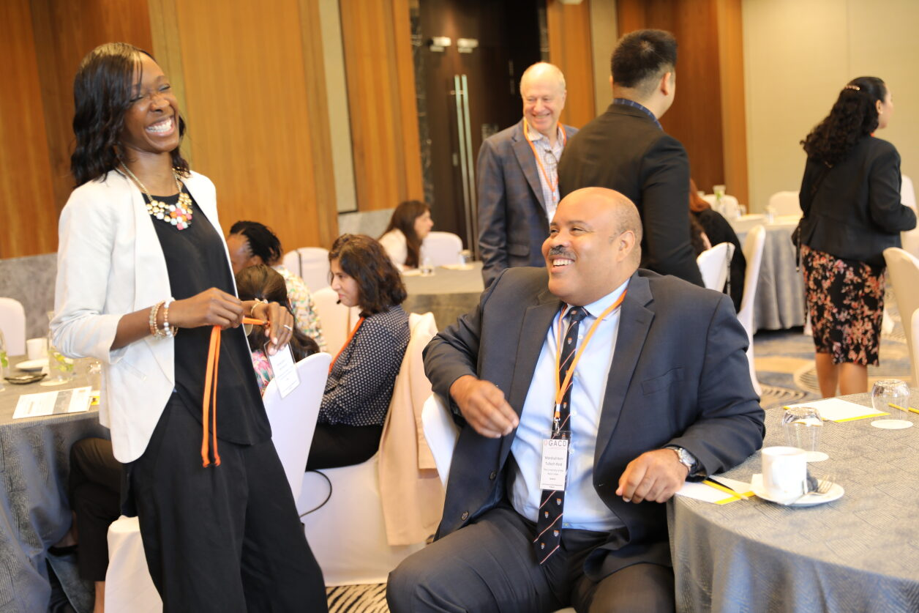

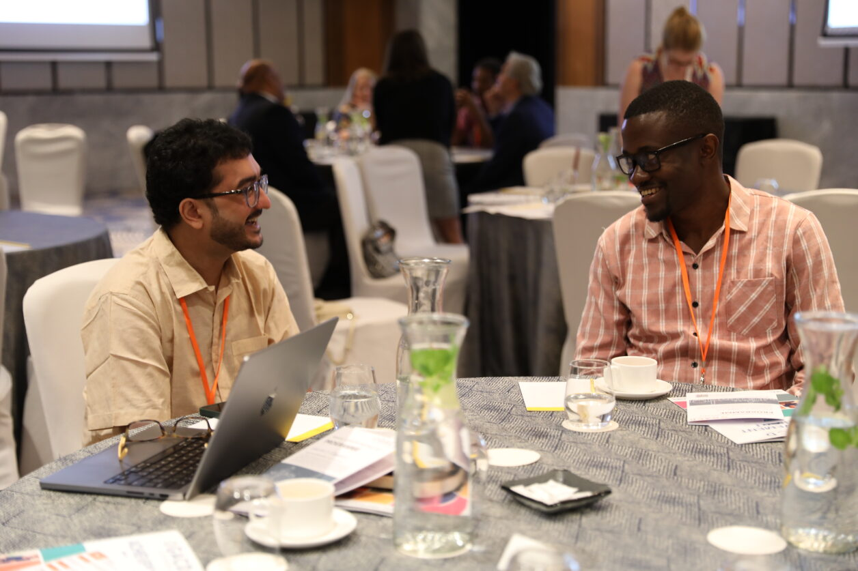
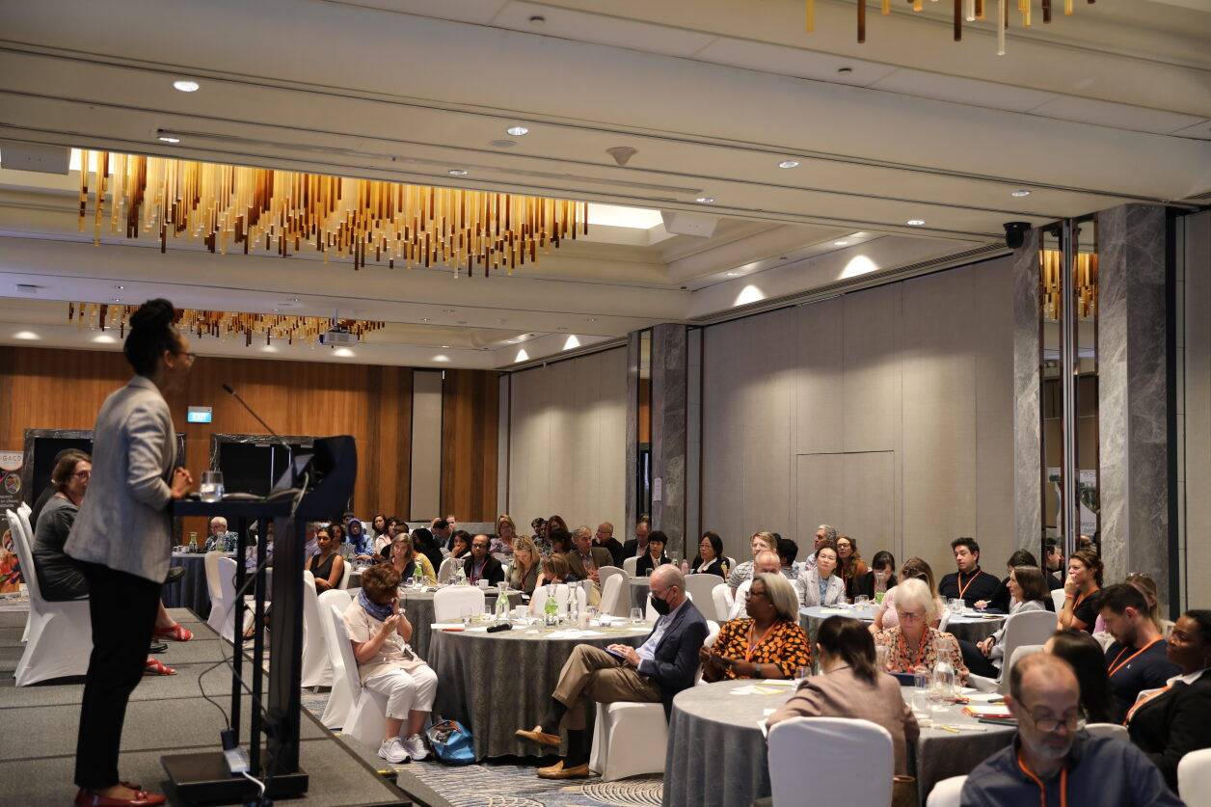
The Global Alliance for Chronic Diseases (GACD)
GACD is the first collaboration of major research funding agencies to address chronic, non-communicable diseases. ​
Together, the members of the alliance represent 80% of global public funding for health research.​

Slide 8











National Health and Medical Research Council, Australia
Sao Paulo Research Foundation, Brazil
Canadian Institutes of Health Research
European Commission
Indian Council of Medical Research
Agency for Medical Research and Development, Japan
Health Research Council of New Zealand
South African Medical Research Council
Health Systems Research Institute, Thailand
UK Medical Research Council
UK Department of Health and Social Care
US National Institutes of Health

Slide 9



GACD’s strategic objectives
Invest in impactful implementation research
Facilitate collaborations and partnerships to support impact
Build implementation science capacity in relation to NCDs

Slide 10









GACD has invested US $375+ million
2012
2024
$68 million
$60 million
$58 million
$57 million
$51 million
$27 million
$39 million
$22 million
Hyper-tension
Diabetes
Lung Diseases
Mental Health
Scale Up
Cancer
Life Course
Healthy Cities
15 projects
17 projects
17 projects
34 projects
27 projects
26 projects
30 projects
17 projects

Slide 11

Mental Health
Scale Up
Lung Diseases
Cancer
34 projects
27 projects
Diabetes
Life Course
17 projects
26 projects
17 projects
GACD Research Network
30 projects
Hyper-tension
Healthy Cities
15 projects
17 projects

Slide 12
What is implementation science?
Implementation science is the study of the methods and strategies that enable research uptake into practice
Relevant in low- and middle-income countries for effective resource use.
Crucial to navigate complex systems for interventions.
GACD emphasises implementation science in its research funding, tackling global implementation challenges.

Slide 13
1. Aims of the report
Section 1 of the report
Pages 9 to 13

Slide 14




Aims of the report
Summarise the 14 GACD-funded diabetes implementation
research projects
Provide an initial synthesis and appraisal of the methods, strategies, results, and impact
Serve as a springboard for researchers to further consider future meta-syntheses of implementation science projects
Invite readers to build on the interpretations presented

Slide 15
Preparation of the report
Data collection
27-question pro forma
Analysis
Extracted data into a database, categorised by GACD staff
Interpretation
Tabulated grouped data
Reviewed by report contributors
Narrative synthesis approach, guided by Popay et al

Slide 16
Preparation of the report – challenges
Intervention retrofitting
Asked project teams to retrofit interventions into contemporary reporting guidelines, outcome frameworks, and strategy categories.
Heterogeneity
Identified inherent variability in research projects, particularly in implementation strategy design and application.
Metasynthesis
Difficulty in identifying a common rubric among implementation research projects.
Contributors made a bold attempt to address this.

Slide 17
2. The Diabetes Research Programme projects
Section 2 of the report
Pages 15 to 23

Slide 18
DM01
DM11
Desarrollo y validación de un software ligado a un portal de internet que facilite el tratamiento médico y el empoderamiento del paciente con diabetes tipo 2, la interacción con el personal médico y la generación de un registro en tiempo real
Improving the management of diabetes in pregnancy in remote Australia
DM02
SMART Diabetes: Systematic Medical Assessment, Referral and Treatment for Diabetes care in China using Lay Family Health Promoters
DM12
Mobile phone text-messaging to support treatment for people with type 2 diabetes in sub-Saharan Africa: a pragmatic individually randomised trial
DM03
IINDIAGO: Integrated INtervention for DIAbetes rIsk after GestatiOnal diabetes
DM13
The Bangladesh D-Magic Trial: Diabetes Mellitus Action through Groups or Information for better Control
DM04
CHAPP: Community Health Assessment Program in the Philippines
DM14
Implementation of foot thermometry and SMS to prevent diabetic foot ulcer
DM07
SMART2D: A people-centred approach through Self-MAnagement and Reciprocal learning for the prevention and management of Type 2 Diabetes
DM15
BIGPIC: Bridging Income Generation with Group Integrated Care
DM08
Feel4Diabetes (Families across Europe following a hEalthy Lifestyle 4 Diabetes prevention
DM16
A lifestyle intervention program for the prevention of type 2 diabetes mellitus among South Asian women with gestational diabetes mellitus
DM10
Desarrollo de una red social interactiva para el control metabolico de los pacientes con diabetes
DM17
Tools and practices to reduce CVD and complications in diabetics in Mexico

Slide 19
DM01
Improving the management of diabetes in pregnancy in remote Australia
DM11
Development and validation of software to provide medical treatment and patient empowerment to type 2 diabetics, through
interaction with medical staff and real-time recording]
DM02
SMART Diabetes: Systematic Medical Assessment, Referral and Treatment for Diabetes care in China using Lay Family Health Promoters
DM12
Mobile phone text-messaging to support treatment for people with type 2 diabetes in sub-Saharan Africa: a pragmatic individually randomised trial
DM03
IINDIAGO: Integrated INtervention for DIAbetes rIsk after GestatiOnal diabetes
DM13
The Bangladesh D-Magic Trial: Diabetes Mellitus Action through Groups or Information for better Control
DM04
CHAPP: Community Health Assessment Program in the Philippines
DM14
Implementation of foot thermometry and SMS to prevent diabetic foot ulcer
DM07
SMART2D: A people-centred approach through Self-MAnagement and Reciprocal learning for the prevention and management of Type 2 Diabetes
DM15
BIGPIC: Bridging Income Generation with Group Integrated Care
DM08
Feel4Diabetes (Families across Europe following a hEalthy Lifestyle 4 Diabetes prevention
DM16
A lifestyle intervention program for the prevention of type 2 diabetes mellitus among South Asian women with gestational diabetes mellitus
DM10
Development of an interactive social network for
metabolic control of patients with diabetes
DM17
Tools and practices to reduce CVD and complications in diabetics in Mexico

Slide 20
Overview of the 14 projects
14 projects
Target populations
Implementation gaps
Risk factors
Implementation strategies
Those at risk of developing T2D, those living with T2D, GDM and/or diabetes in pregnancy, or a combination
Improving quality of care, health promotion, cost-effective health screening, prevention and/or control
Lifestyle factors, metabolic syndrome, mental health and wellbeing, social factors, health literacy and systemic factors
Knowledge building and the use of m-Health activities were the most common
20 countries, all based in LMICs and/or working with underserved populations

Slide 21
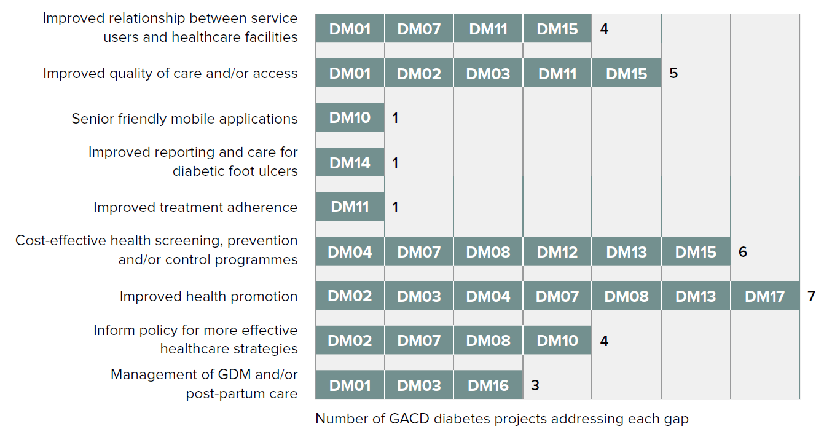
Implementation gaps addressed by the 14 diabetes projects

Slide 22
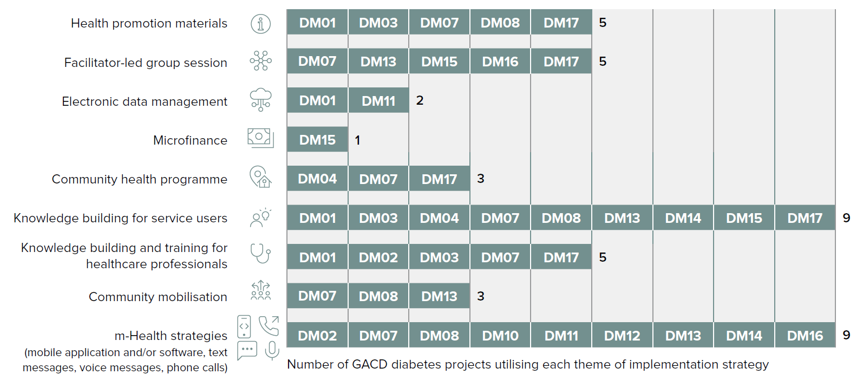
Summary of implementation strategies used across the 14 diabetes projects

Slide 23
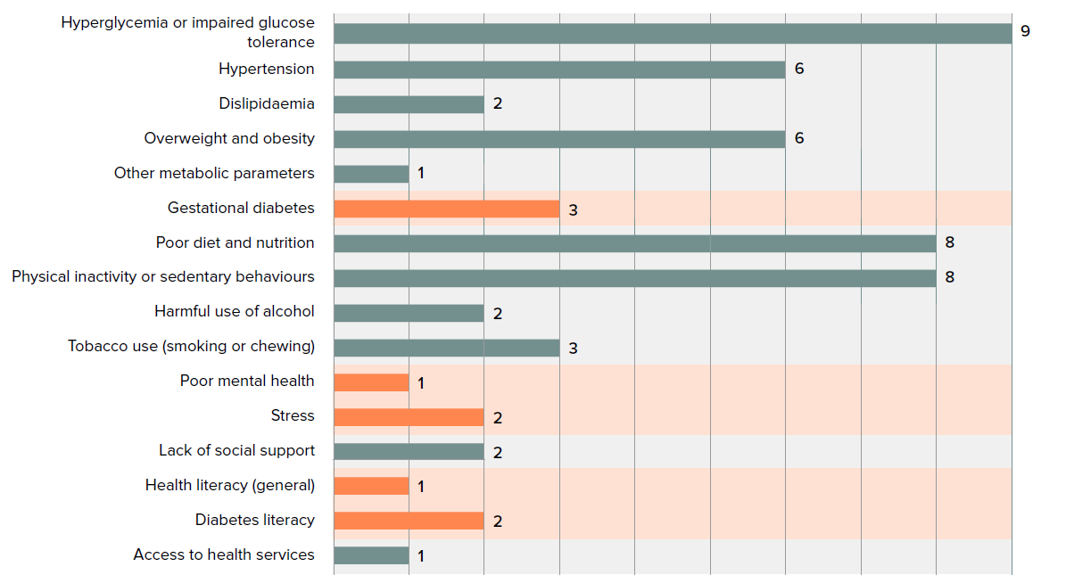
Risk factors addressed across the 14 diabetes projects,
grouped by risk factor category
Top group, components of metabolic syndrome; Second group, GDM; Third group, lifestyle factors; Fourth group, mental health and wellbeing;
Fifth group, social factors; Sixth group, health literacy; Last group, systemic factors.

Slide 24
3. Theories of change
Section 3 of the report
Pages 25 to 27

Slide 25
What are theories of change and logic models?
Theories of change and logic models are different ways of visualising the pathway from a problem to a desired outcome.
They are important at multiple stages throughout an implementation research project.
Theories of change focus on the “why” – causal relationships and assumptions
Logic models focus on the “what” – inputs, activities, outputs, and outcomes

Slide 26
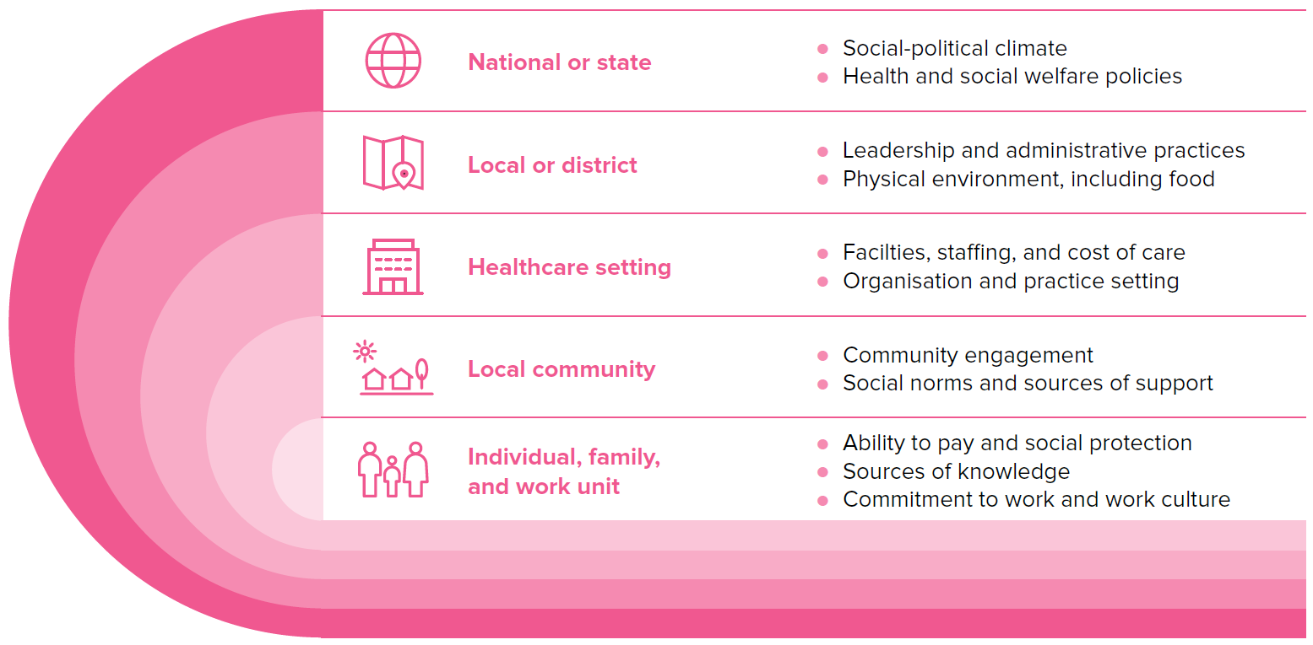
Eleven projects used a theory of change or logic model
DM17 provides an example of a multi-layered context framework, building from the socio-ecological model and the COACH tool
These layers of influence then informed the development of their logic model, depicting the anticipated process from inputs, to activities, to outcomes (next slide)
DM17’s multi-layered framework for measuring context in clinical settings

Slide 27
DM17’s project logic model
Inputs | Activities | Short-term outcomes | Medium-term outcomes | Long-term outcomes | Goal
People with diabetes who participate in chronic disease self-help groups (GAM) within state-run health centers. Government guidelines for GAM and diabetes and cardiovascular disease prevention. Previous evidence-based interventions. | 13 weekly education sessions: Information on diabetes management and cardiovascular risk reduction Small-group discussion and reflection. Participatory education techniques aimed at awareness-raising. Goal-setting and weekly monitoring of glucose, blood pressure, eating and physical activity habits. Physical activity routine. | Acquire information and skills to make healthy changes to nutrition and physical activity habits for diabetes self-management. Improve biomedical indicators: BMI HbA1c LDL and HDL cholesterol Triglycerides Blood pressure | Learn how to make and maintain healthy eating and nutrition behaviour change. Promote family and community involvement in diabetes secondary prevention. Reduce stress related to living with diabetes. | Maintain individual behavior change goals for longer than three months. Foster empowerment; personal and collective agency. Improve emotional well-being. Promote self-help group cohesion. | Improve the physical and emotional well-being of participants with diabetes.
Health center staff who facilitate existing chronic disease self-help groups (GAM): nurses, health promoters, physicians, among others. | Train GAM facilitators to implement MSD. Provide materials (including MSD Facilitator Handbook and Participant Workbook). Provide instructions that encourage self-evaluation. | Learn participatory methodology for health promotion and diabetes secondary prevention education. Improve skills for facilitating GAM and other chronic disease prevention interventions. | Promote an emphasis on salutogenesis rather than pathogenesis. Promote facilitator self-evaluation and continuous improvement of GAM implementation. | Broaden the focus of diabetes prevention and care activities within health centers from the individual patient level to other socioecological levels. Extend the focus of diabetes care beyond a biomedical approach. | Reinforce a health promotion perspective within the health sector.

Slide 28
4. Stakeholder engagement
Section 4 of the report
Pages 29 to 33

Slide 29



What is stakeholder engagement?
Involves: Identifying, understanding, and addressing the needs, concerns, and perspectives of individuals and groups affected by the research.
Benefits: Increases the relevance, acceptability, and sustainability of research findings.
Strategies: Active participation, communication, and collaboration with stakeholders throughout the research process.

Slide 30
21 stakeholder groups were engaged across projects
Engaged in 14 projects:
Service users
Engaged in 8 projects:
Local policymakers
Engaged in 5 projects:
Family and/or carers
Healthcare professionals
National policymakers

Slide 31
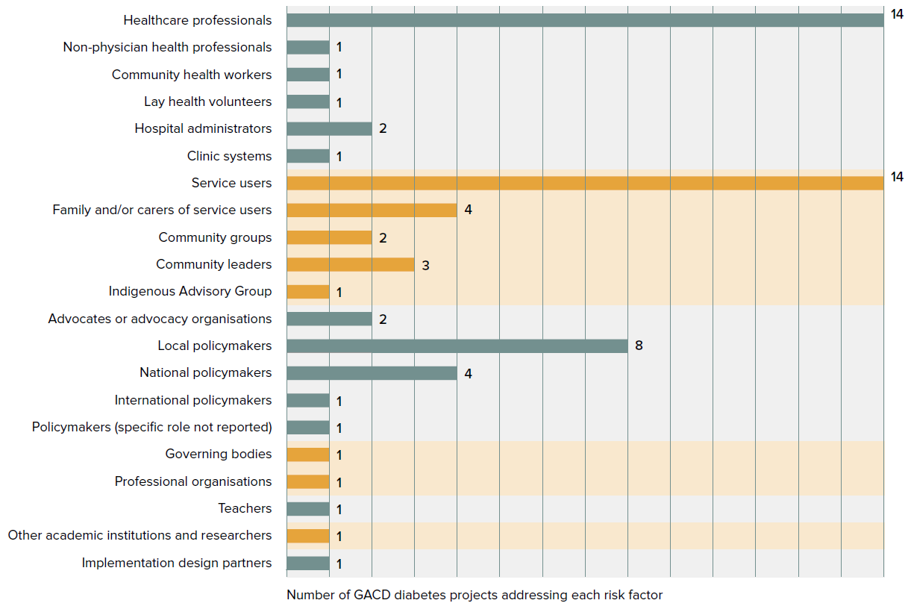
Stakeholder groups and frequency of engagement across the 14 diabetes projects

Slide 32


Engagement strategies varied in style and timing
Most groups were engaged during development or implementation stages
Common tools were interviews, meetings, group discussions or surveys

Slide 33
5. Research methods
Section 5 of the report
Pages 35 to 41

Slide 34
Six different study designs were used across projects
A feasibility study
A prospective observational study
Pre/post analyses
A hybrid type 2 effectiveness-implementation study
Individual randomised trial
Cluster randomised trials
Mixed methods were the most favoured approach by researchers

Slide 35
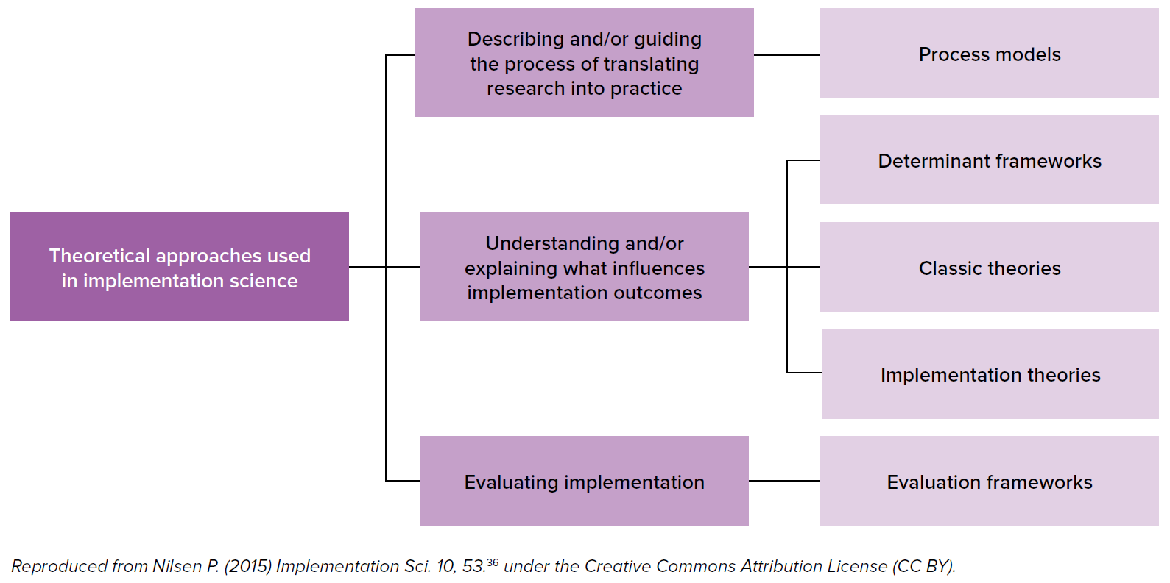
Implementation theories and evaluation frameworks were the most frequently used Nilsen (2015) categories

Slide 36
Theories, models, and frameworks (TMFs)
Total
Most common
Multipurpose
17 TMFs used across different functions
COM-B, RE-AIM, and the MRC Framework
Formative work, intervention implementation, strategy refinement, and evaluation
11 TMFs were used for more than one purpose
Applications

Slide 37
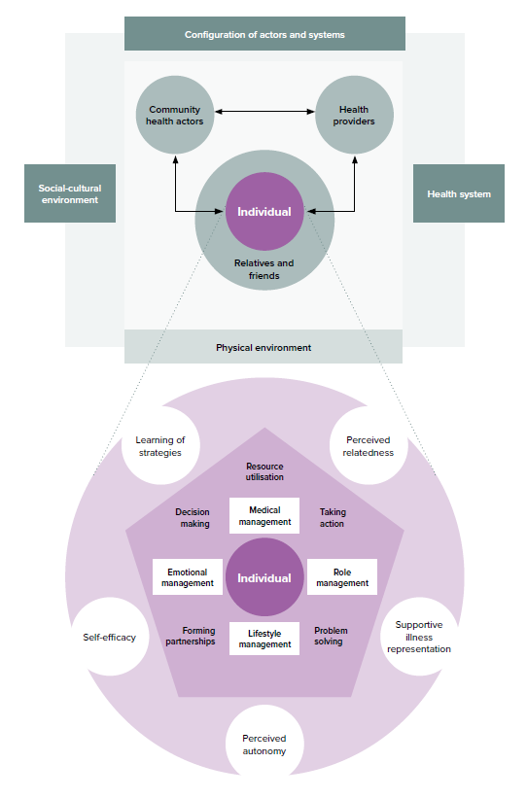
DM07 created a framework for their project
Their tailormade framework incorporates elements of:
Behaviour change theories
Chronic care models
Health systems theories
Contextual data
DM07’s tailored framework (from De Man et al., 2019³⁹).
De Man et al., 2019 framework for SMART2D project

Slide 38
6. Assessing context
Section 6 of the report
Pages 43 to 49

Slide 39
What is context?
Context might include:
Equipment at the healthcare facility
Knowledge of doctors, nurses, and other health workers
Attitudes of patients and families
Local guidelines
Access to medication
Trust in healthcare professionals
Cyclical and unexpected weather conditions
Demographics
… and many more factors and interactions
“Context is the set of circumstances or unique factors that surround a particular implementation effort”
Damschroder LJ et al. 2009
Context can be thought of as the active ecosystem into which an intervention is implemented

Slide 40
Categories of barriers and enablers
Context specific barriers and enablers across projects were found to fall under broad categories of:
Community behaviours
Knowledge and education
Access to healthcare facilities and/or medication
Data collection, recording and referrals
Human resources
Practitioner trust
Confidence and/or expertise
Health systems and structure
Stakeholder involvement
Political climate
Economic status
Inclusivity
Natural disasters and emergencies

Slide 41
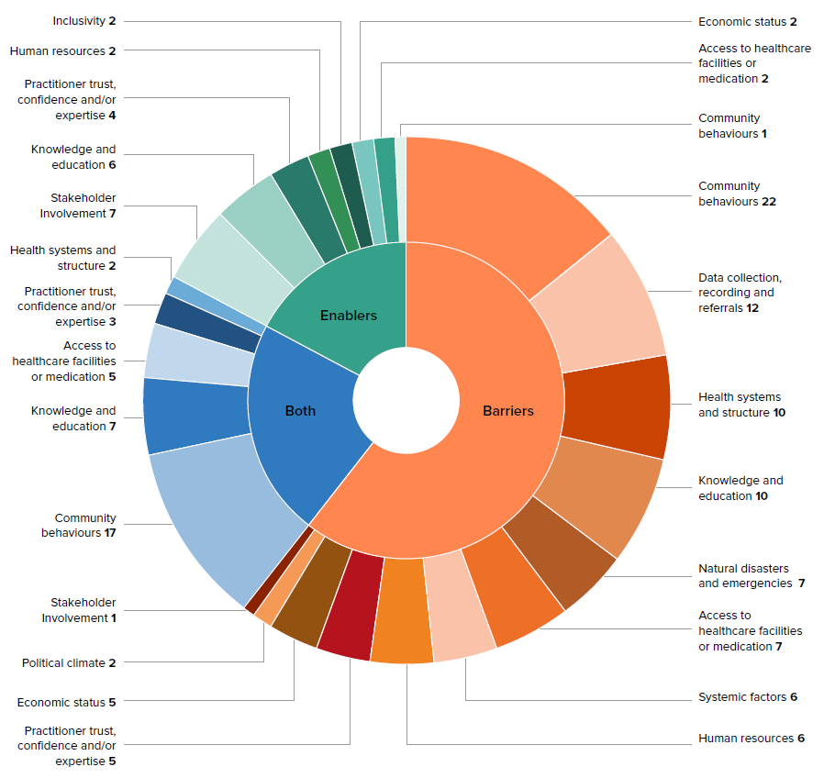
Sunburst diagram of context-specific barriers and enablers faced by the 14 diabetes projects

Slide 42
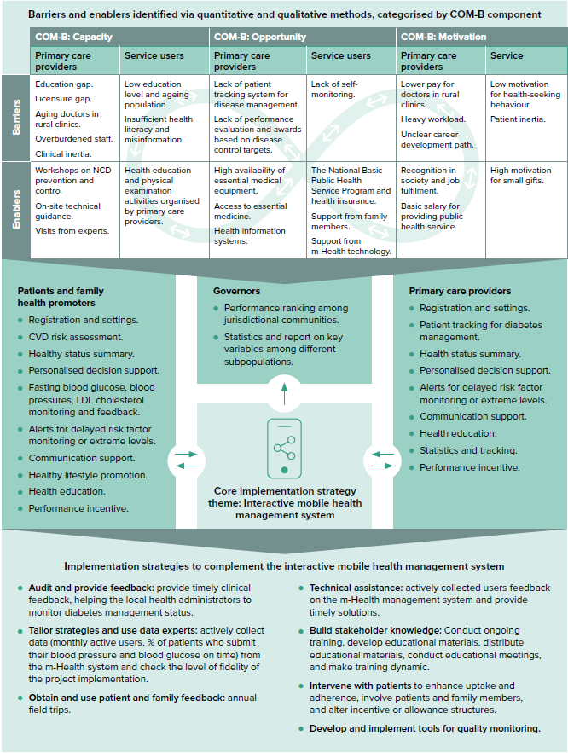
The DM02 project team undertook 42 stakeholder interviews with patients, family, health workers, and administrators
Barriers and enablers were mapped onto the COM-B model
Developed a tailored, interactive mobile health management system
Integrated with assistive implementation strategies
DM02’s journey from context assessment to implementation strategies

Slide 43
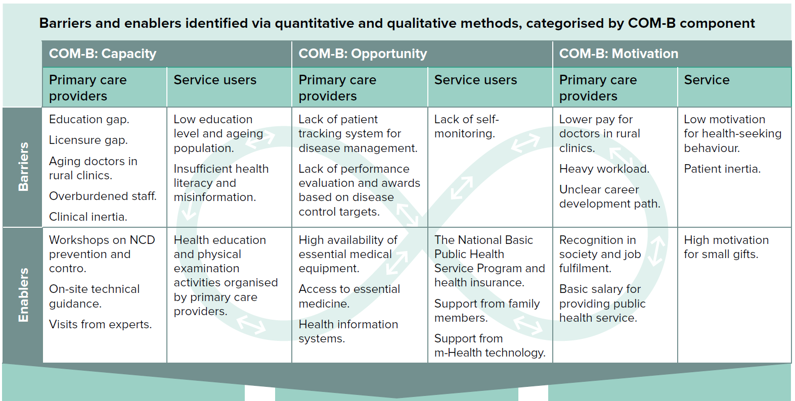
DM02’s journey from context assessment to implementation strategies

Slide 44
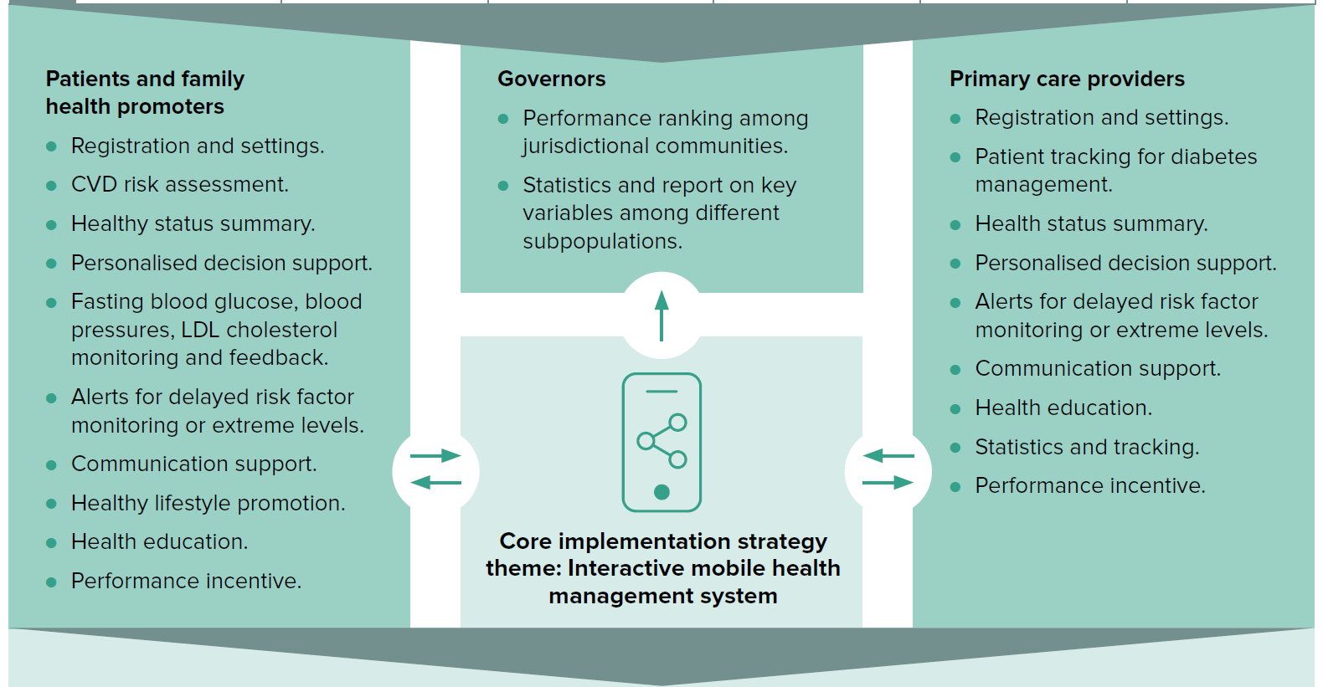
DM02’s journey from context assessment to implementation strategies

Slide 45
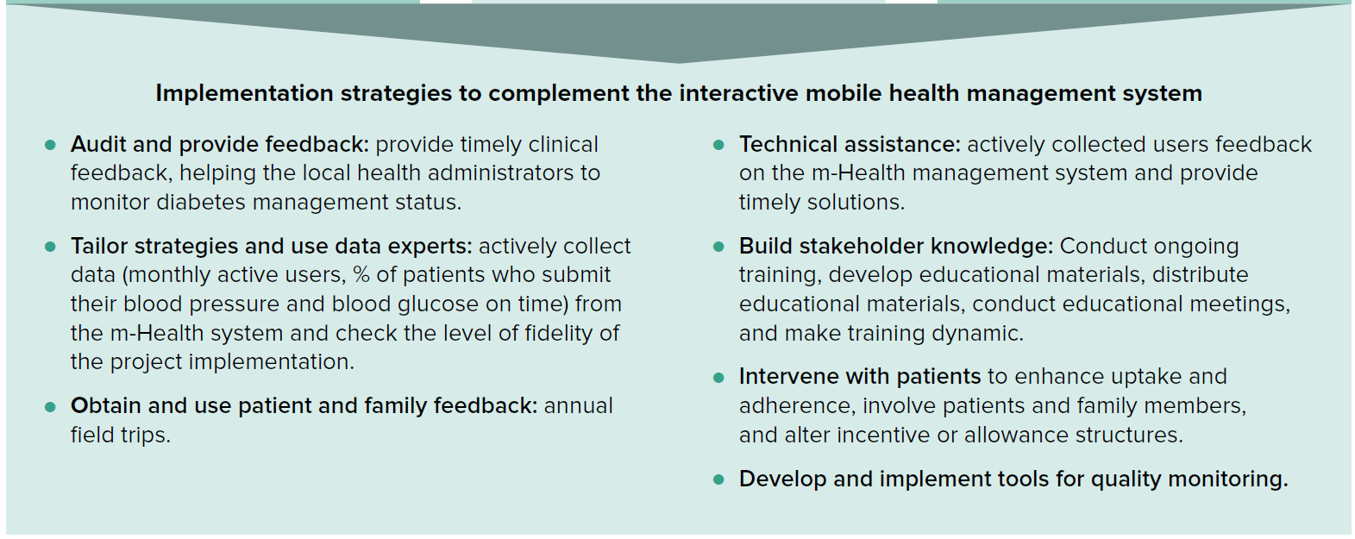
DM02’s journey from context assessment to implementation strategies

Slide 46
Understanding context and equity is critical
Some contextual factors were consistently barriers or enablers across all projects
Other factors differed depending on the setting
For example…
Community behaviours, such as fear, could be an enabler where fear of getting sick made service users more likely to adhere to a healthy lifestyle, or as a barrier where fear of healthcare professionals or medication leads to lack of health seeking or adherence to medication

Slide 47
Equity challenges bought to light the importance of social determinants of health
e.g., Inequity of resources between academic institution partners
e.g., Gender inequality
e.g., No access to cell (mobile) phones
e.g., Distance to travel to group sessions
e.g., Conflicting working hours of group members
Systemic factors
Environmental factors
Age, sex, and constitutional factors
Living and working conditions
Social and community networks

Slide 48
7. Implementation strategies
Section 7 of the report
Pages 51 to 60

Slide 49

What are implementation strategies?
An implementation strategy is a detailed plan outlining how an evidence-based intervention will be put into practice.
A well-crafted implementation strategy ensures that an evidence-based intervention is carried out effectively and efficiently, maximising its potential impact.

Slide 50
Standardised categories of strategies
Categorising strategies
Reporting strategies and outcomes
Several efforts to standardise the lexicon for different implementation strategies have been made
Leeman et al.’s five classes of implementation strategies
Expert Recommendations for Implementing Change (ERIC) project.
To further aid transparency and comparability, Proctor and colleagues proposed standardise reporting of implementation strategies and related outcomes.

Slide 51
Standardised categories of strategies
Implementation science remains an emerging field, so consistency in terminology and classification is difficult
Eleven projects reported 24 implementation strategies according to Proctor et al.’s framework and the ERIC categories
Projects reported between one and eight implementation strategies with varying levels of detail
Some projects reported each strategy individually, while others opted to report multifaceted strategy ‘bundles’ together
DM02
DM03
DM04
DM08
DM10
DM11
DM12
DM13
DM14
DM16
DM17

Slide 52
For the report, nine themes were created to describe the strategies implemented by the projects:
Community health programmes
Community mobilisation
Electronic data management
Facilitator-led sessions
Health promotion materials
Knowledge building and training for healthcare professionals
Knowledge building for service users
Microfinance
m-Health*
*Includes telephone calls, text messages, voice messages and mobile applications and/or software

Slide 53
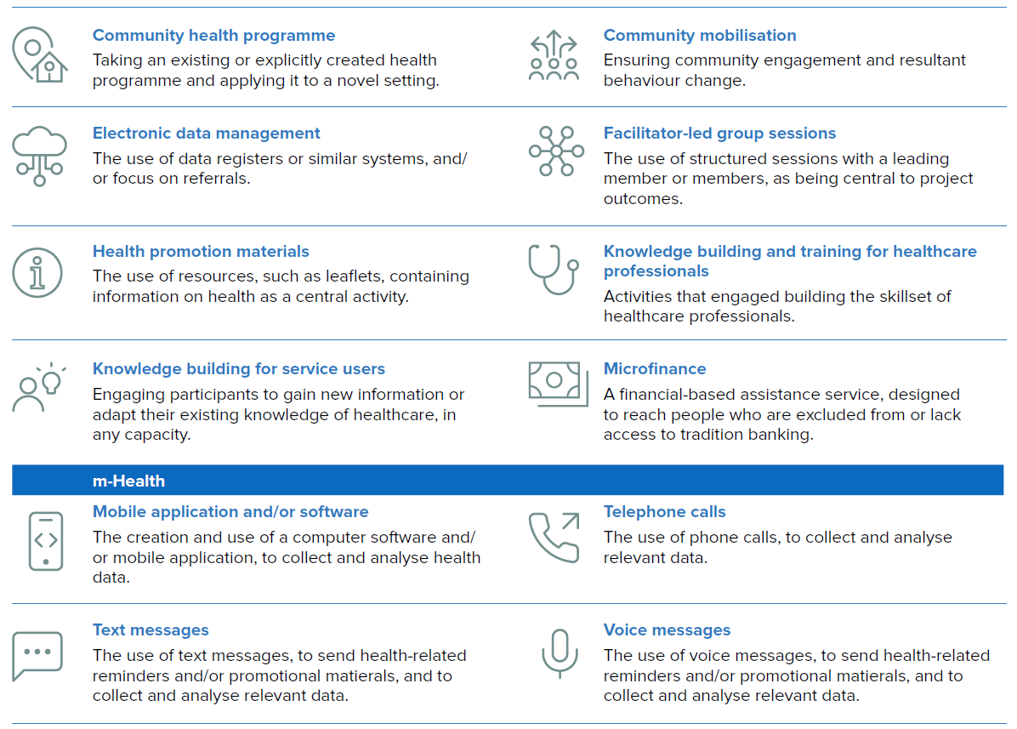

Slide 54
Most commonly implemented theme: Knowledge building for service users
Second most commonly implemented: m-Health strategies
The impact of m-Health varied, with successes often related to a different strategy within the same project
Community health programmes
Community mobilisation
Electronic data management
Facilitator-led sessions
Health promotion materials
Knowledge building and training for healthcare professionals
Knowledge building for service users
Microfinance
m-Health*
*Includes telephone calls, text messages, voice messages and mobile applications and/or software

Slide 55

The trends across commonly grouped themes create scope for future tailored research in these areas
Example 1
Telephone calls and voice messages were always accompanied by facilitator-led group sessions, but not vice versa
www.gacd.org/our-impact/diabetes-report

Slide 56

The trends across commonly grouped themes create scope for future tailored research in these areas
Example 2
Health promotion materials were always accompanied by knowledge building for service users, as were community health programmes and community mobilisation
www.gacd.org/our-impact/diabetes-report

Slide 57
The following matrix should be read left to right. Pink boxes indicate that when the strategy theme in the left-hand column was used in a project, it was always paired with the strategy theme noted in the top row, but not necessarily vice versa. For example, when the strategy theme of community health programmes was employed, this was always paired with knowledge building for service users; however, the strategy theme of knowledge building for service users was not always paired with community health programmes.
See page 57 in the report for further discussion.

Slide 58
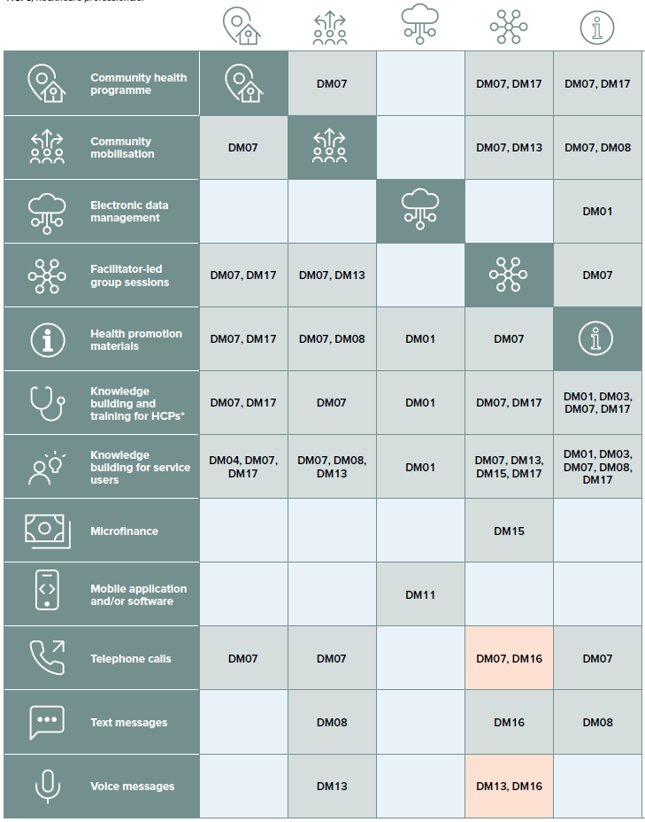
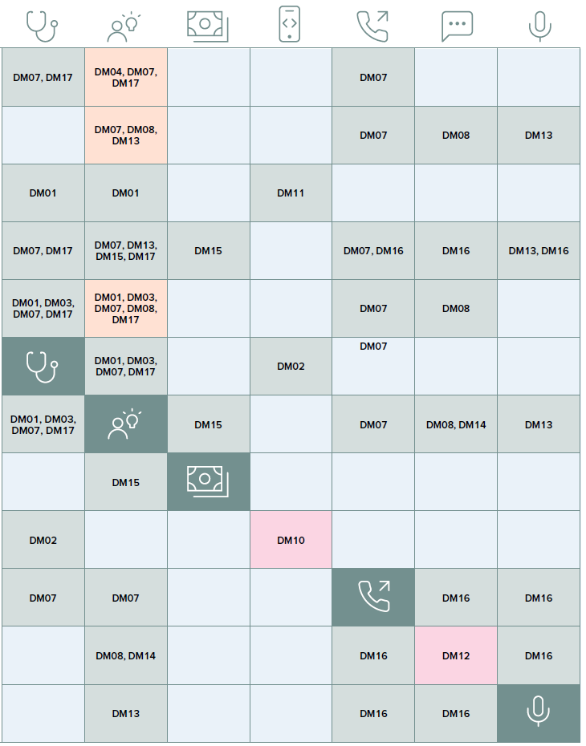
Matrix showing which implementation strategy themes were used in combination, and by which projects

Slide 59
8. Key findings
Section 8 of the report
Pages 61 to 72

Slide 60

Summary of measures
Clinical effectiveness outcomes were the most common measures across all projects, followed by system level outcomes.
Social determinants of health were measured by three projects.
Implementation outcomes reported using the Proctor et al. 2011 framework varied across projects.

Slide 61
Project teams were asked to provide concise summaries of their work’s contribution to implementation science
Overarching messages: The importance of low-cost, accessible initiatives (screening, training, education, group medical visits) and the need to deeply assess contextual factors.
Accessibility: Taking interventions into communities and integrating with them was crucial.
‘Big picture messages’ (1)

Slide 62
Project teams were asked to provide concise summaries of their work’s contribution to implementation science
Low-intensity training: Smaller-scale successes highlight the potential of low-intensity training for healthcare professionals, though further research is needed to assess cost-efficiency and impact.
Other themes: Improving data transparency through electronic collection and sharing and the use of m-Health as supplementary tools were less common but still noteworthy.
‘Big picture messages’ (2)

Slide 63
9. Impact
Section 9 of the report
Pages 73 to 83

Slide 64



Twelve projects reported impact
The most common themes of impact were:
Strengthened national health systems to respond to the burden of diabetes
Influence on national health programmes, strategies or guidelines
Programme scale up

Slide 65
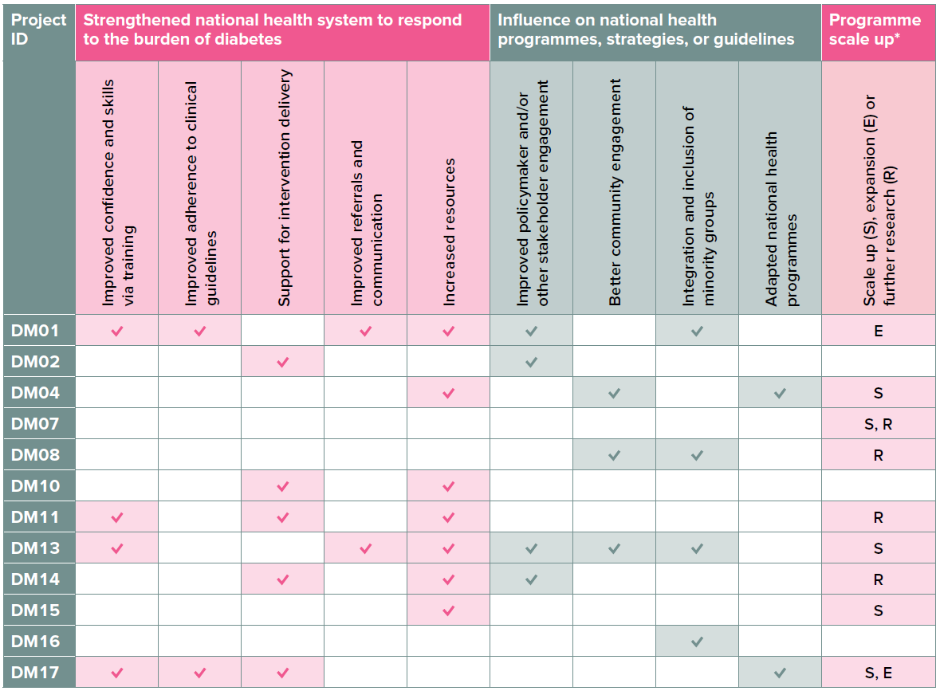
Types of impact reported by the 14 diabetes projects

Slide 66
Data sharing and collaboration
Data sharing and collaboration across the GACD encompasses the GACD Research Network, working groups, international partnerships, and in-person meetings.
Research capacity is developed through activities ranging from workshops to an e-Hubs to training programmes.
The GACD publications portal showcases all outputs produced from the GACD Diabetes Research Programme.
A unique strength of GACD projects is their collective action on NCDs through collaboration

Slide 67
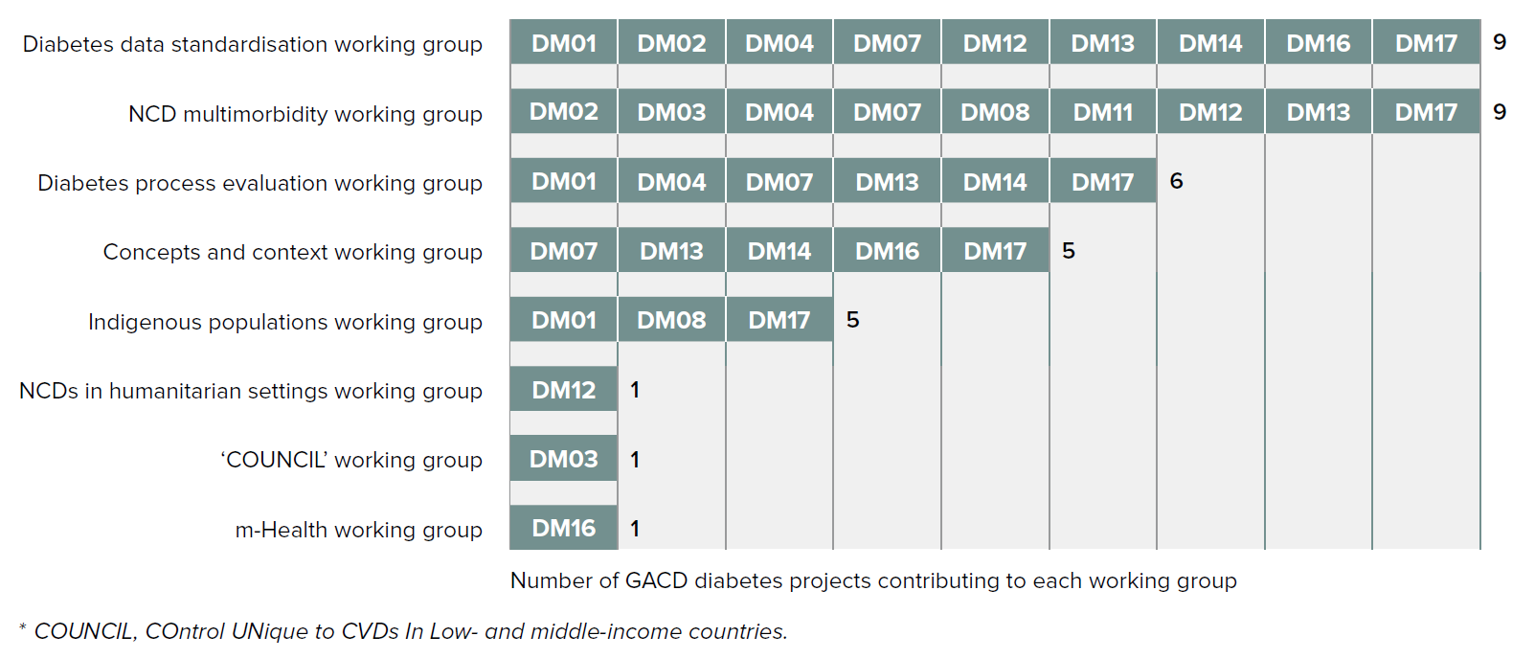
Contributions to GACD inter-project working groups by the 14 diabetes projects

Slide 68
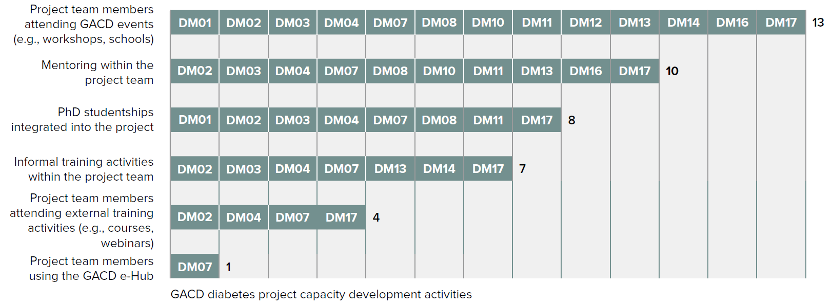
Capacity development activities across the 14 diabetes projects

Slide 69
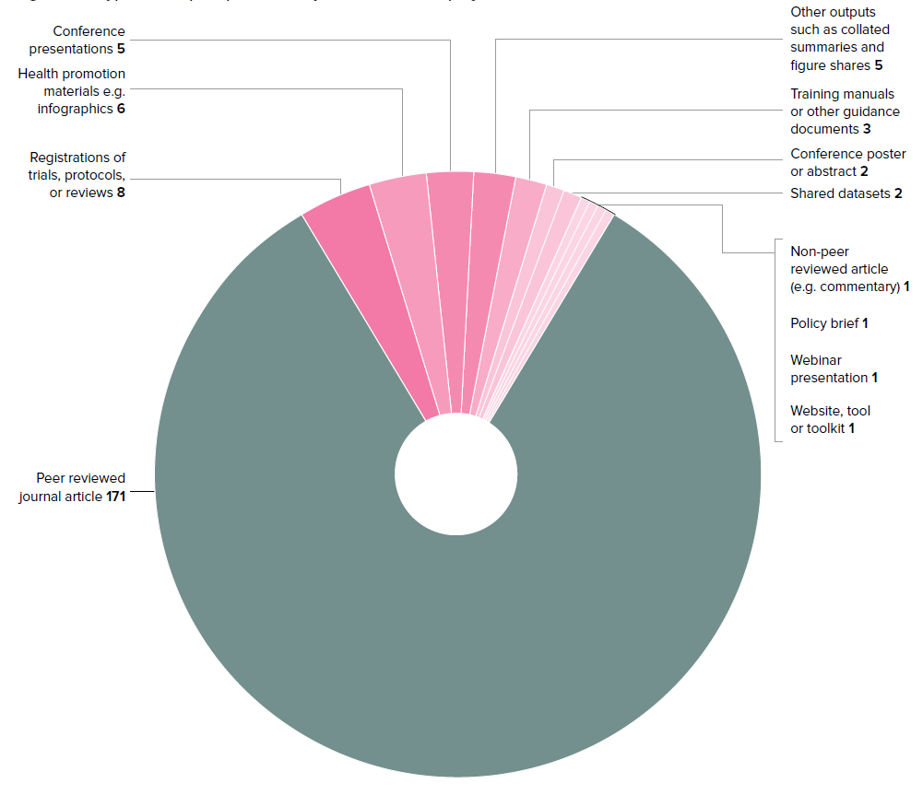
Types of outputs published by the 14 diabetes projects
Find these publications and more on the GACD Publications Portal:
www.gacd.org/resources
Outputs from the14 diabetes projects

Slide 70
10. Lessons learned
Section 10 of the report
Pages 85 to 89

Slide 71




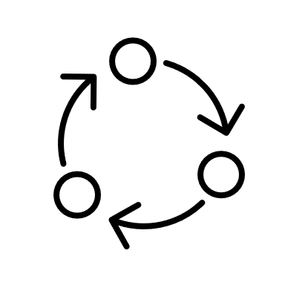

Six core lessons learned
Collaborate for success
Tailor to context
Technology is a tool, not a silver bullet
Address health inequities
Consider sustainability from the start
Expect the unexpected

Slide 72
11. Conclusions
Section 11 of the report
Page 91

Slide 73
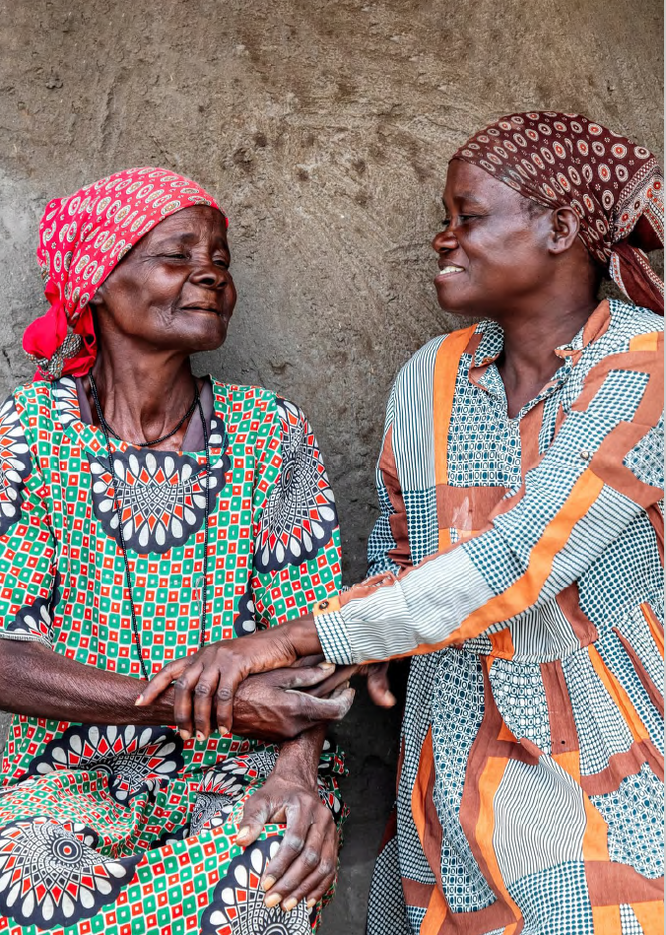
Concluding remarks
Implementation research is transformative.
Multi-stakeholder collaboration leads to success.
Notable outcomes include improving healthcare professionals’ knowledge and strengthening health systems.
Challenges remain in standardising research methods and conducting meta-analyses.
Notes:
The GACD Diabetes Research Programme has demonstrated the transformative power of implementation research in addressing the global diabetes crisis.
A cornerstone of the programme’s success has been its emphasis on multi-stakeholder collaboration.
The programme has achieved notable outcomes, particularly in improving healthcare professionals’ knowledge and strengthening health systems.
While implementation science has evolved rapidly, challenges remain in standardising research methods and conducting comprehensive meta-analyses.

Slide 74

Concluding remarks
The COVID-19 pandemic highlighted the importance of resilient healthcare systems.
Tailored dissemination outputs ensure that findings are understood and actionable.
Promoting health equity should remain central to implementation efforts.
Notes:
The COVID-19 pandemic highlighted the importance of flexible and resilient healthcare systems.
Beyond traditional academic publications, the programme has embraced a variety of tailored dissemination outputs to ensure that findings are understood and actionable.
Addressing health disparities and promoting health equity should remain central to diabetes research and implementation efforts.
The future of diabetes implementation research lies in nurturing collaboration, embracing innovation, and leveraging data-driven insights to drive sustainable health outcomes.

Slide 75
The future of diabetes implementation research lies in nurturing collaboration, innovation, and leveraging data-driven insights

Slide 76
Acknowledgements
Lead author: Maisha Syed – Research Assistant
GACD secretariat:
Izzy Bandurek – Research Capacity Manager
Margaret Bee – Senior Policy & Impact Manager
Carolyn Johnson – Programme Manager
Ekow Tachie-Mensah – Communications Officer
Morven Roberts – Chief Executive Officer
On behalf of the GACD Programme Subcommittee: Patricia Ridgeway – National Health and Medical Research Council, Australia
The following people helped to shape the nature and core content of the report, from reviewing the initial data collection form to appraising the first draft:
Gina Agarwal – McMaster University, Canada
Peter Delobelle – University of the Western Cape, South Africa
Edward Fottrell – University College London, UK
Brian Oldenburg – Baker Heart & Diabetes Institute, Australia
Francisco Salazar Gonzalez – Universidad De Monterrey, Mexico
Josefien van Olmen – University of Antwerp, Belgium
The GACD secretariat are indebted to the people who took the time and effort to collate data from across the duration of their project and kindly agreed to share it in the spirit of open collaboration.

Slide 77






www.gacd.org
@gacd_media
tinyurl.com/GACD-linkedin
@GACDmedia
admin@gacd.org

